Slide 1
Self-care and Resilience in Challenging Times Part One: First Steps
Jeffrey E. Barnett, Psy.D., ABPP
LCAS Dean’s Office
November 2, 2020

Slide 2
Self-care, Resilience, and our Challenging Times
The Challenging Times in Which we Live
Challenges in our Professional and Personal Lives and How They Interact
Ongoing Threats to Our Wellness
Why This All Matters

Slide 3
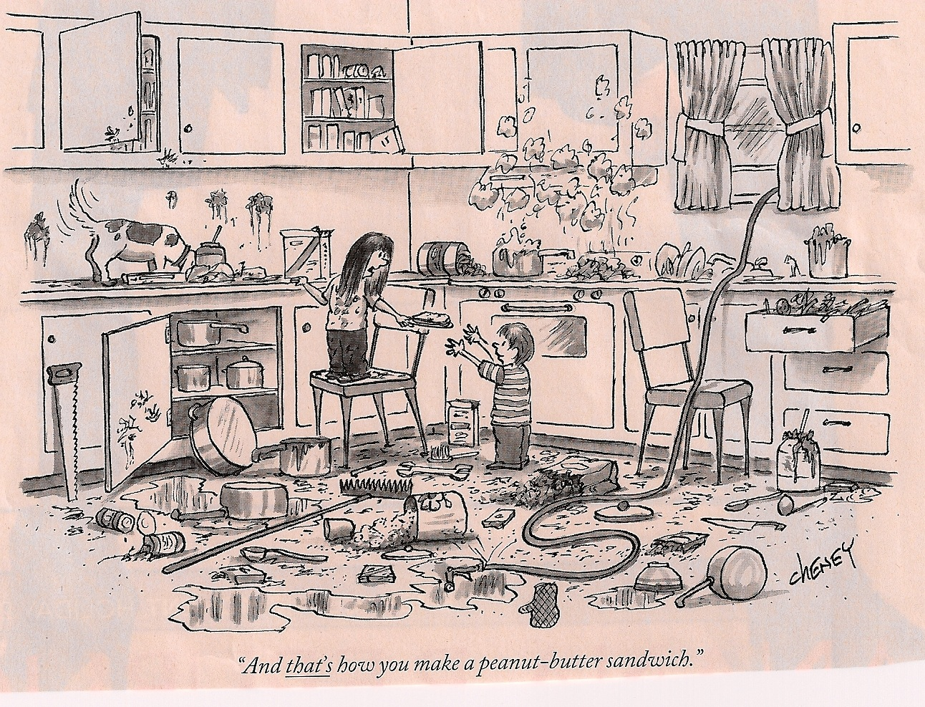

Slide 4
Distress, Burnout, and Wellness
Distress
Understanding Burnout
Feelings of Emotional Exhaustion and Energy Depletion
Loss of Caring; Feelings of Negativity or Cynicism Related to One’s Job
Reduced Professional Efficacy and Loss of Feelings of Accomplishment
The Stress-Distress Continuum
Flourishing ⬅️ Survival ⬅️ Stress ➡️ Distress ➡️ Burnout

Slide 5
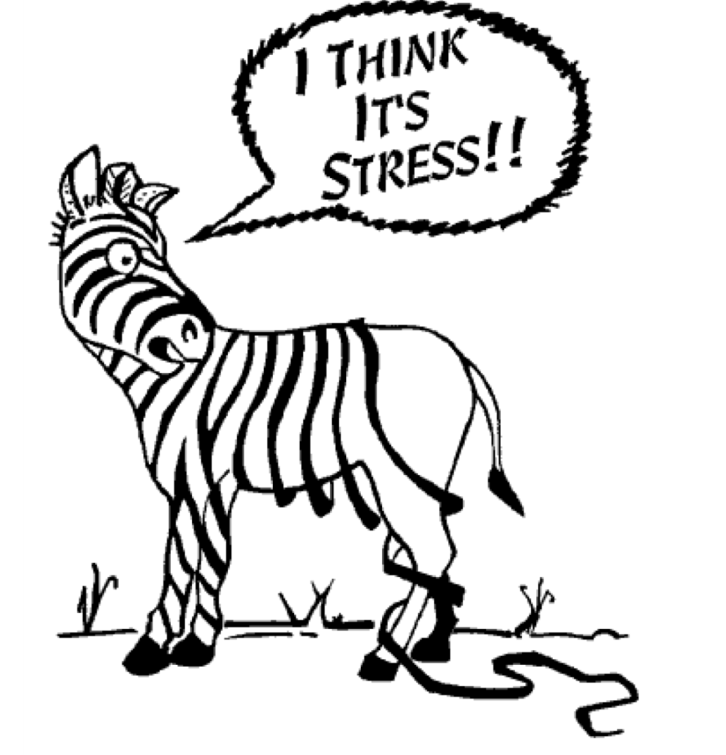

Slide 6
What is Self-Care?
What Self-Care Is and Isn’t
Self-Care Myths
Do’s and Don’t’s of Self-Care
Positive Career-Sustaining Behaviors
Maladaptive Coping Strategies
Balance as a Life Goal
Seeking Support and Not Going It Alone

Slide 7
Resilience
What is Resilience?
How to Develop and Enhance Your Resilience
Resilience Pitfalls and Opportunities
Resilience, Self-Care, and Wellness

Slide 8
Key Points to Keep in Mind
Accepting the Need for Self-Care, Prioritizing It, Planning for It
Overcoming Guilt
Self-care as an Approach and Process, Not an End Result
Not an All or Nothing Endeavor
Striving For Balance
Asking for Help and Not Going It Alone

Slide 9
Let’s Get Started
For Your Consideration:
What are the Major Stressors in Your Life at Present?
What Positive Self-care Activities Do You Engage In?
What Barriers to Effective Self-Care Do You Experience at Present?
What Negative or Maladaptive Coping Strategies Do You Use?
What Changes Are Needed for Your Life to be More in Balance?
How Can You Promote Your Resilience Moving Forward

Slide 10
More to Come
Session 2
Are you at risk of burnout? Understanding its signs and what to do about them.
Understanding personal and professional challenges, risk factors, and blind spots.
Session 3
Why self-care and the promotion of wellness is not an independent activity.
How to begin developing your own self-care plan now.
Session
Creating a culture of self-care.
Implementing your self-care plan.

